Slide 1
INFO 450 - Data Science Project
Tien Nguyen

Slide 2
Problem Statement
Video games have been growing in popularity and because of that learning which games sell where is an important distinction to know
Not all games are created equal
Knowing the preferences of various regions will allow for publishers to make smarter decisions when it comes to marketing
Marketing a game where the customer base is non existent would be a waste of time and money (however creates new questions)

Slide 3
Methodology
Created data visualization based on various relationships (platform x global sales, platform x regional sales, genre x regional sales, etc.)
Data visualizations lead to clear customer trends
Grouping data by platform and years to see which consoles were the most popular, and which year had the most sales

Slide 4
Findings
Certain regions have clear favorites
Xbox has almost no customer base in Japan
Japan has a fondness for Nintendo and handhelds (DS)
The rise of competition likely why certain consoles did not have a majority of sales
PC gains popularity between 2005 and 2010 making PS4 and Xbox One sales seem smaller
Some data might not be completely accurate since the dataset doesn’t take into account multiplatform games (only labels one platform per game)

Slide 5
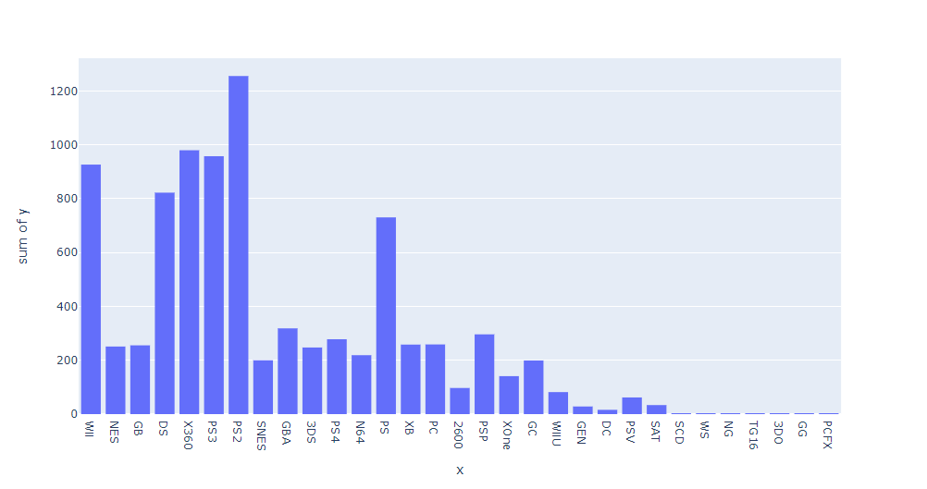
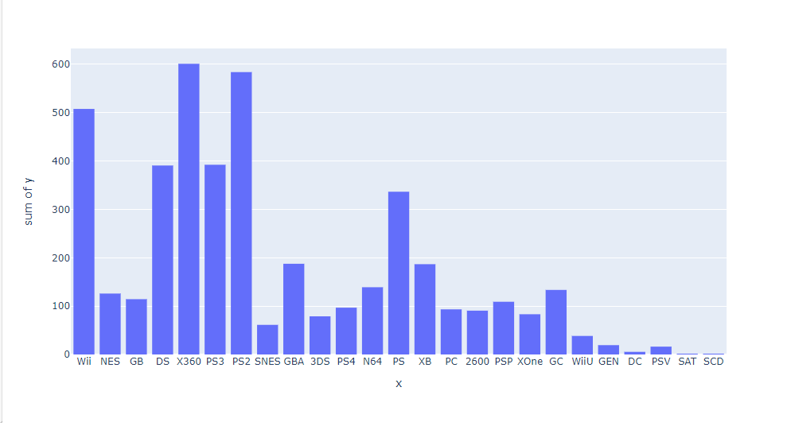
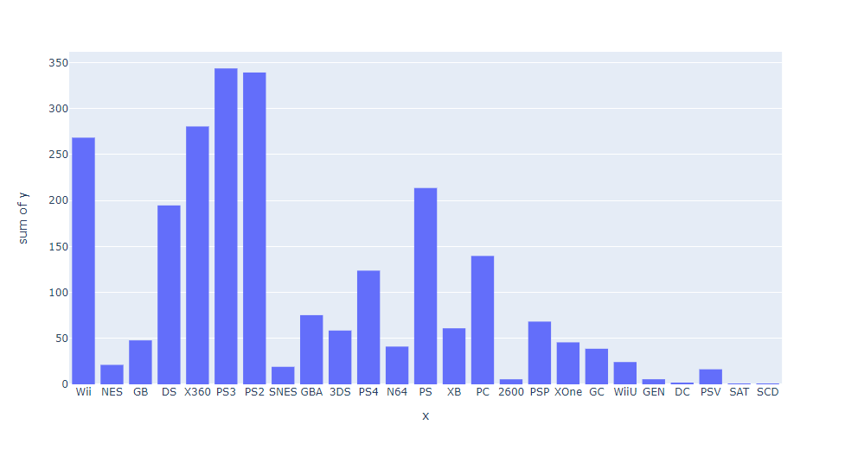
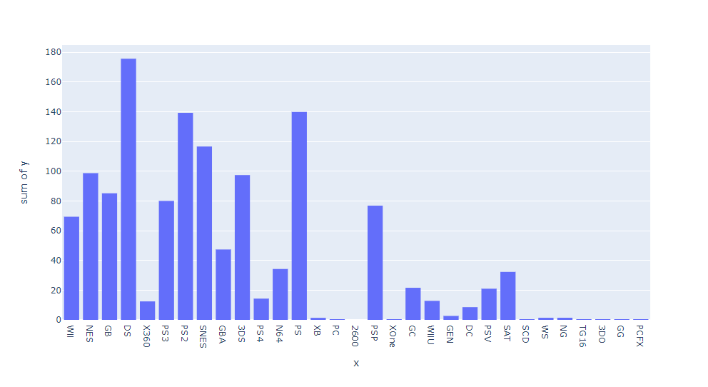
Results (Histogram: Platform x Sales)
Global Sales
NA Sales
EU Sales
JP Sales

Slide 6
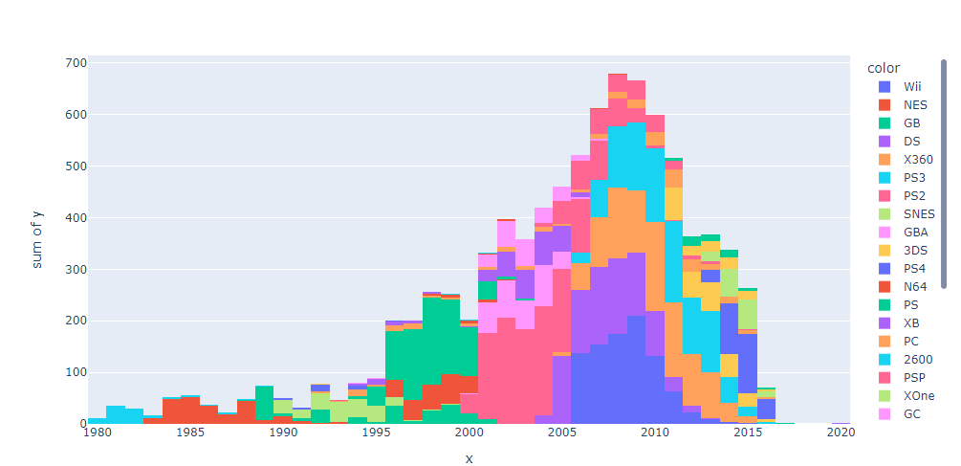
Results (Histogram: Year x Global Sales)

Slide 7
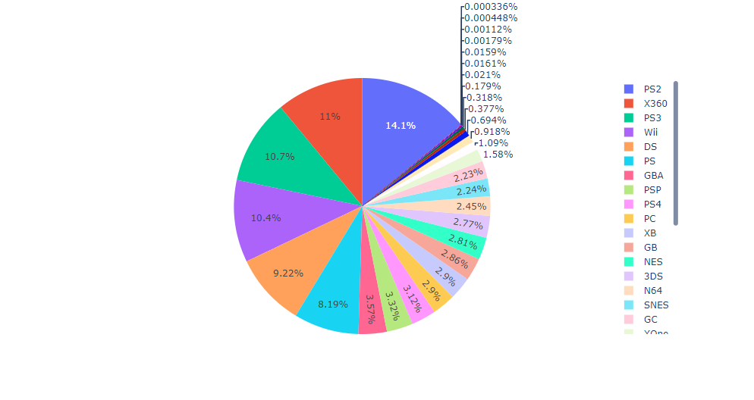
Results (Pie Graph: Global Sales x Platform)

Slide 8
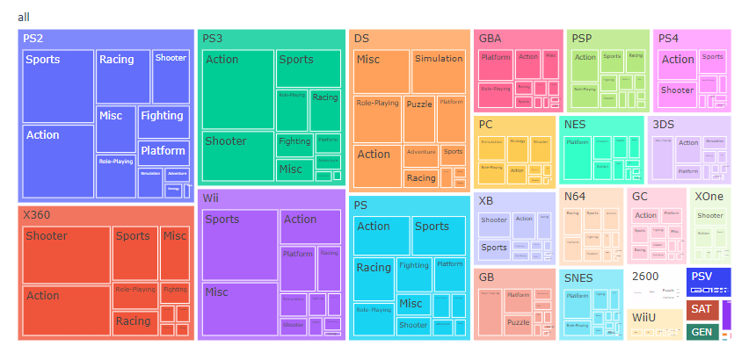
Results (Treemap: Platform x Genre)

Slide 9
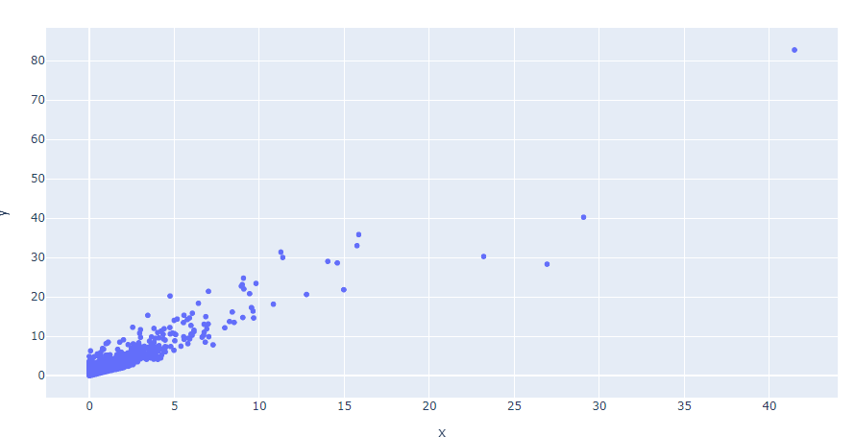
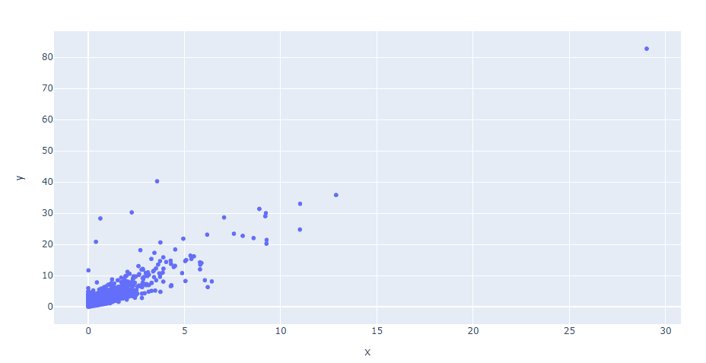

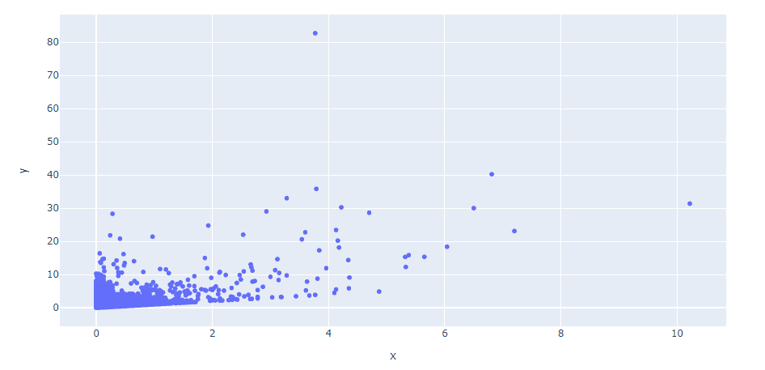


Results (Scatterplot: Regional Sales x Global Sales)
NA Sales
EU Sales
JP Sales

Slide 10
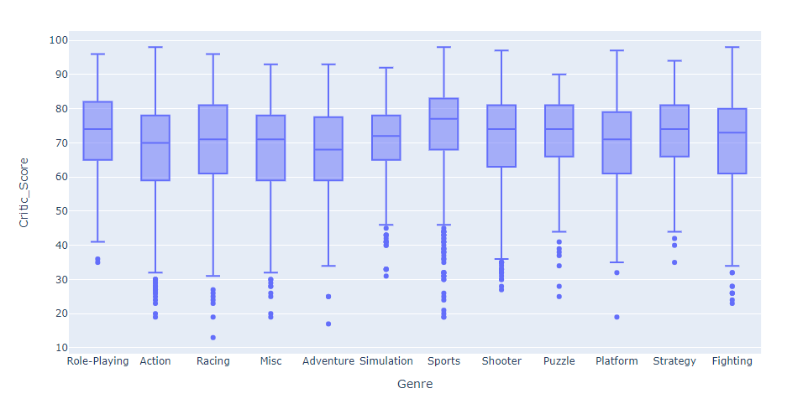
Results (Box-and-Whisker Plot (different dataset)

Slide 11
Make Recommendations
Game devs should look into making Action, Shooter, or Sports games
US and EU make a majority of global sales so those markets would be beneficial to appeal to
If trying to appeal to JP region, try to incorporate RPG elements due to the preferred genre there
Don’t market Xbox only games in JP

